Slide 1
Fuzz Testing – Establish Settings
AVCDL-Implementation-10.1.1
Charles Wilson
Staff Product Cybersecurity Architect
version 4
2026-05-26
Notes:
Script:
I'm Charles Wilson, staff product cybersecurity architect at Torc Robotics.
This presentation will cover the Fuzz Testing Settings Establishment activity.

Slide 2
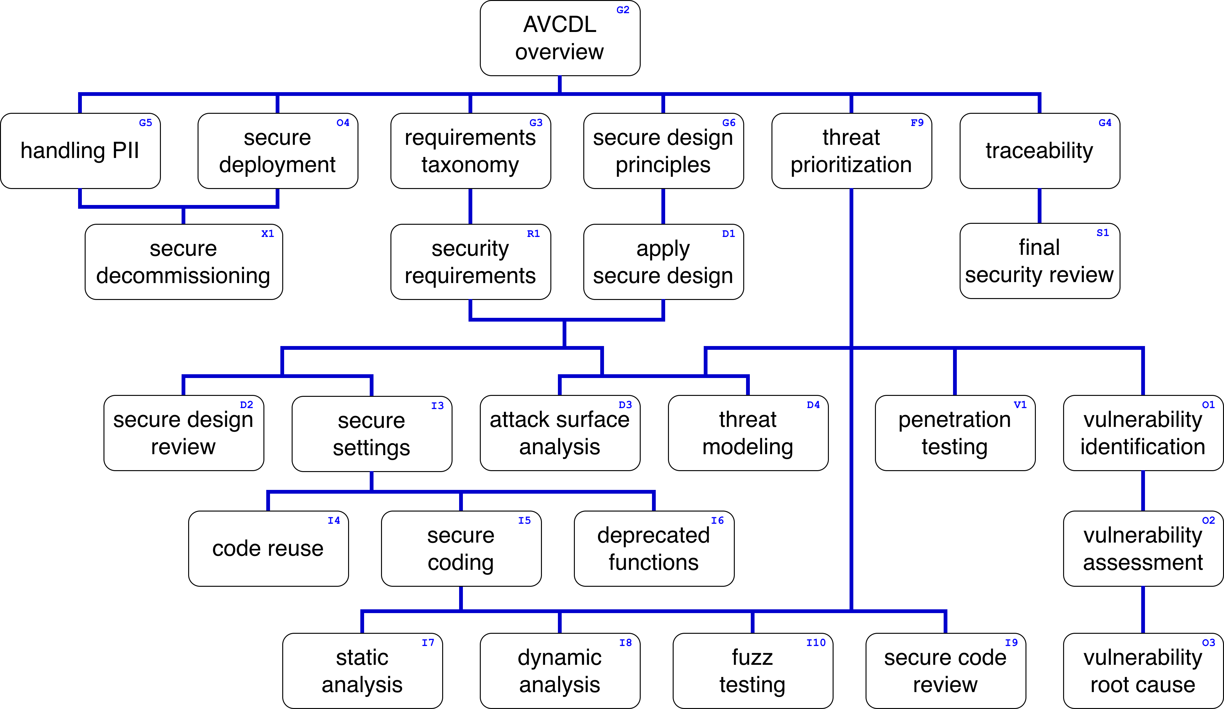
Training Path
Notes:
Script:
This diagram shows the overall AVCDL training path.
If you're taking this training, it's assumed that you've already completed the AVCDL Overview training,
and additionally, that you've completed the
Requirements Taxonomy
Security Requirements
Secure Design Principles
Apply Secure Design
Threat Prioritization
Secure Settings
Secure Coding
and
Fuzz Testing Overview
trainings.
This training will cover the Fuzz Testing - Establish Settings activity.

Slide 3
Workflow
Notes:
Script:
Before getting into settings establishment, let's briefly review where it fits, in the overall fuzz testing process.

Slide 4
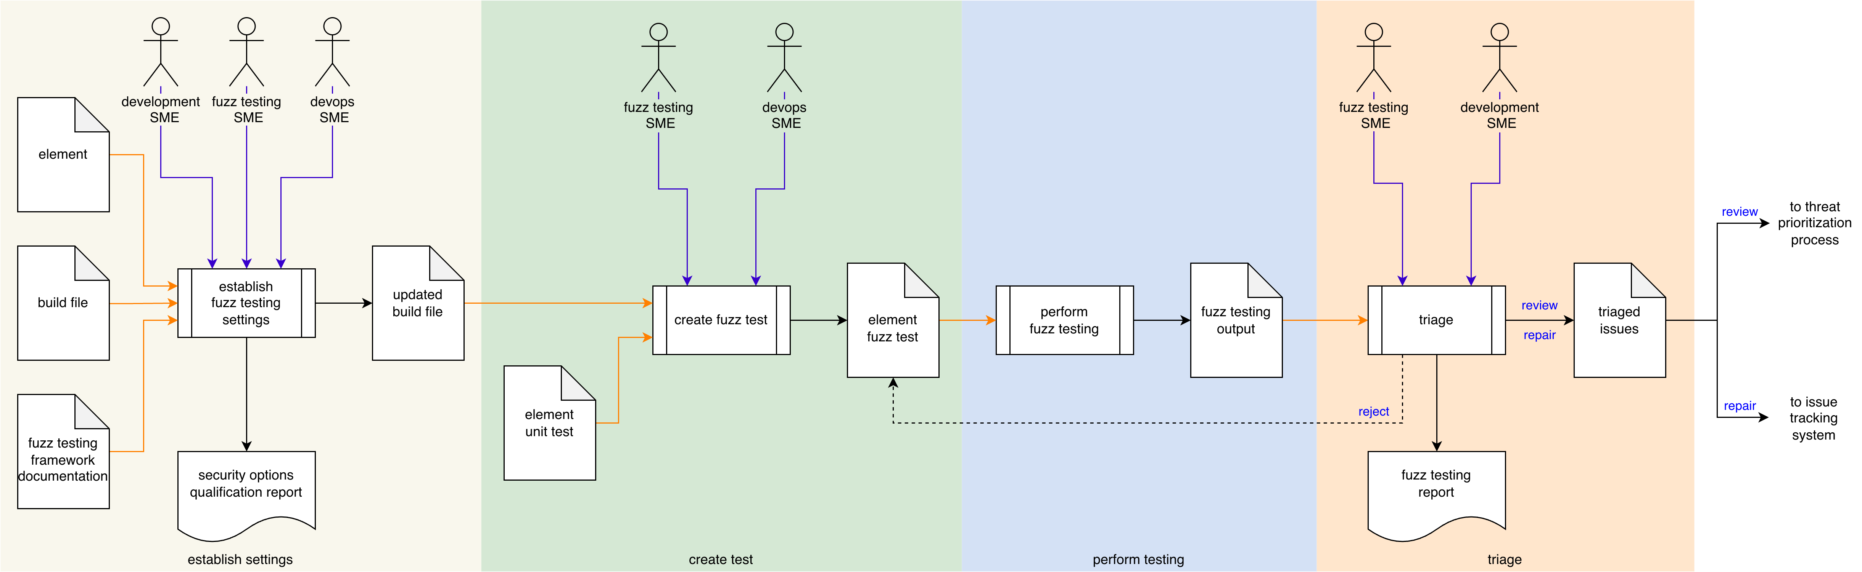
Process Workflow
Notes:
Script:
Here's the fuzz testing process which we previously covered in the Fuzz Testing Overview training.
[break]
Our focus for this training is going to be on the first activity, that of settings establishment.

Slide 5
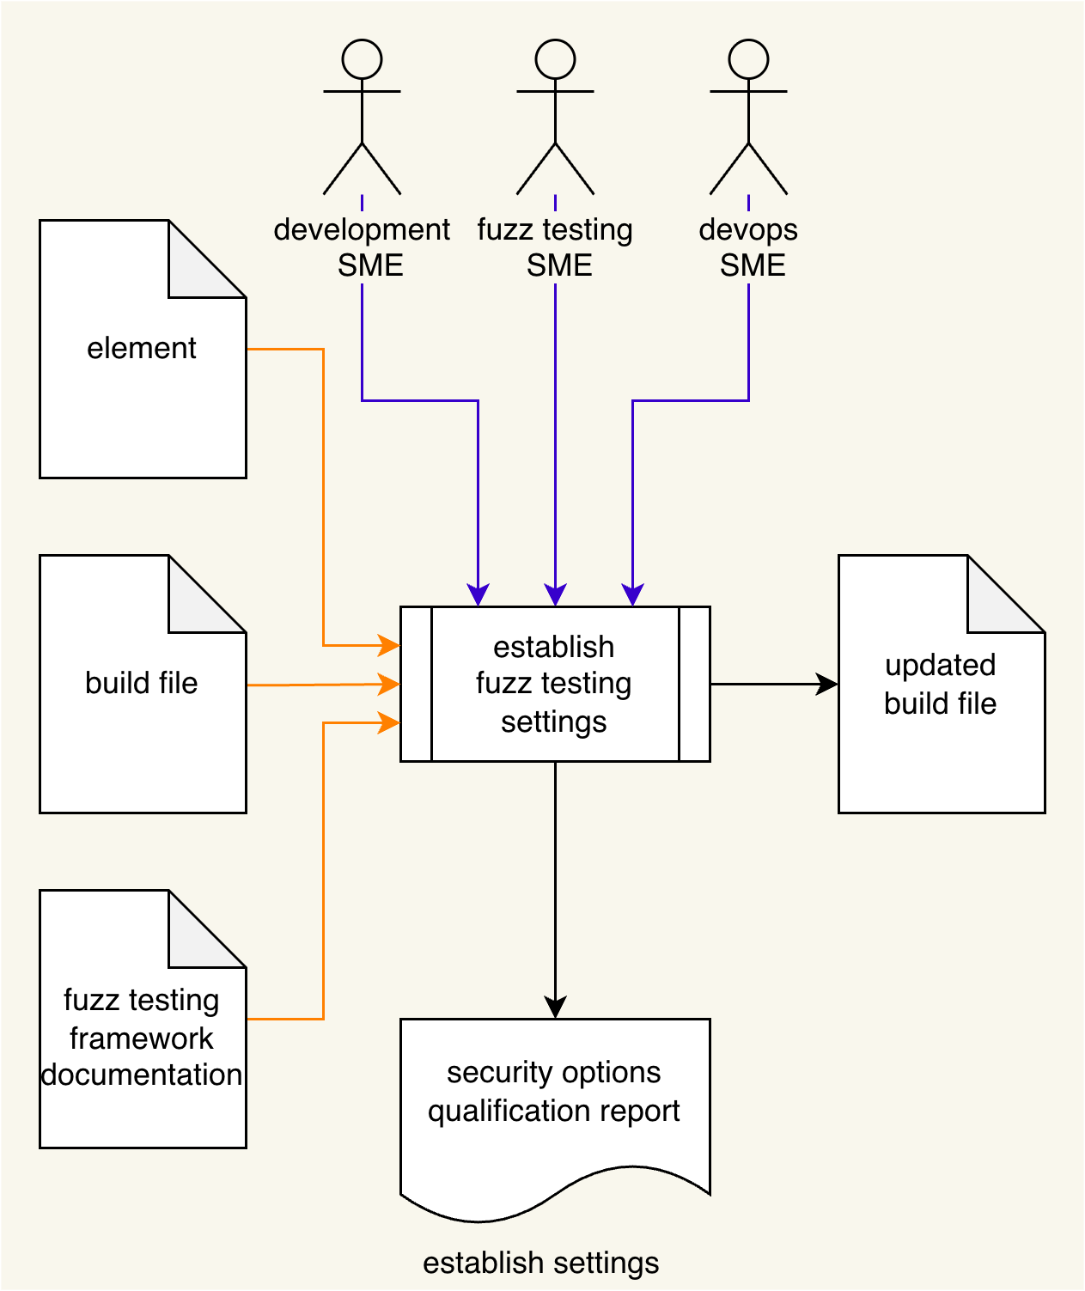
Process Workflow
Notes:
Script:
Here's the fuzz testing process which we previously covered in the Fuzz Testing Overview training.
[break]
Our focus for this training is going to be on the first activity, that of settings establishment.

Slide 6
Establish Settings Activity
Notes:
Script:
Within the settings establishment activity, the development SME, fuzz testing SME, and devops SME take
[pause]
the element,
[pause]
the build file, and
[pause]
the fuzz testing framework documentation, and
[pause]
establish a set of element-specific settings to be used for fuzz testing.
These will be put into
[pause]
an updated build file and produce
[pause]
a security options qualification report.
[pause]
If this diagram seems really information dense, that's because this is an encapsulation of the secure settings process.
Let's review that process.

Slide 7
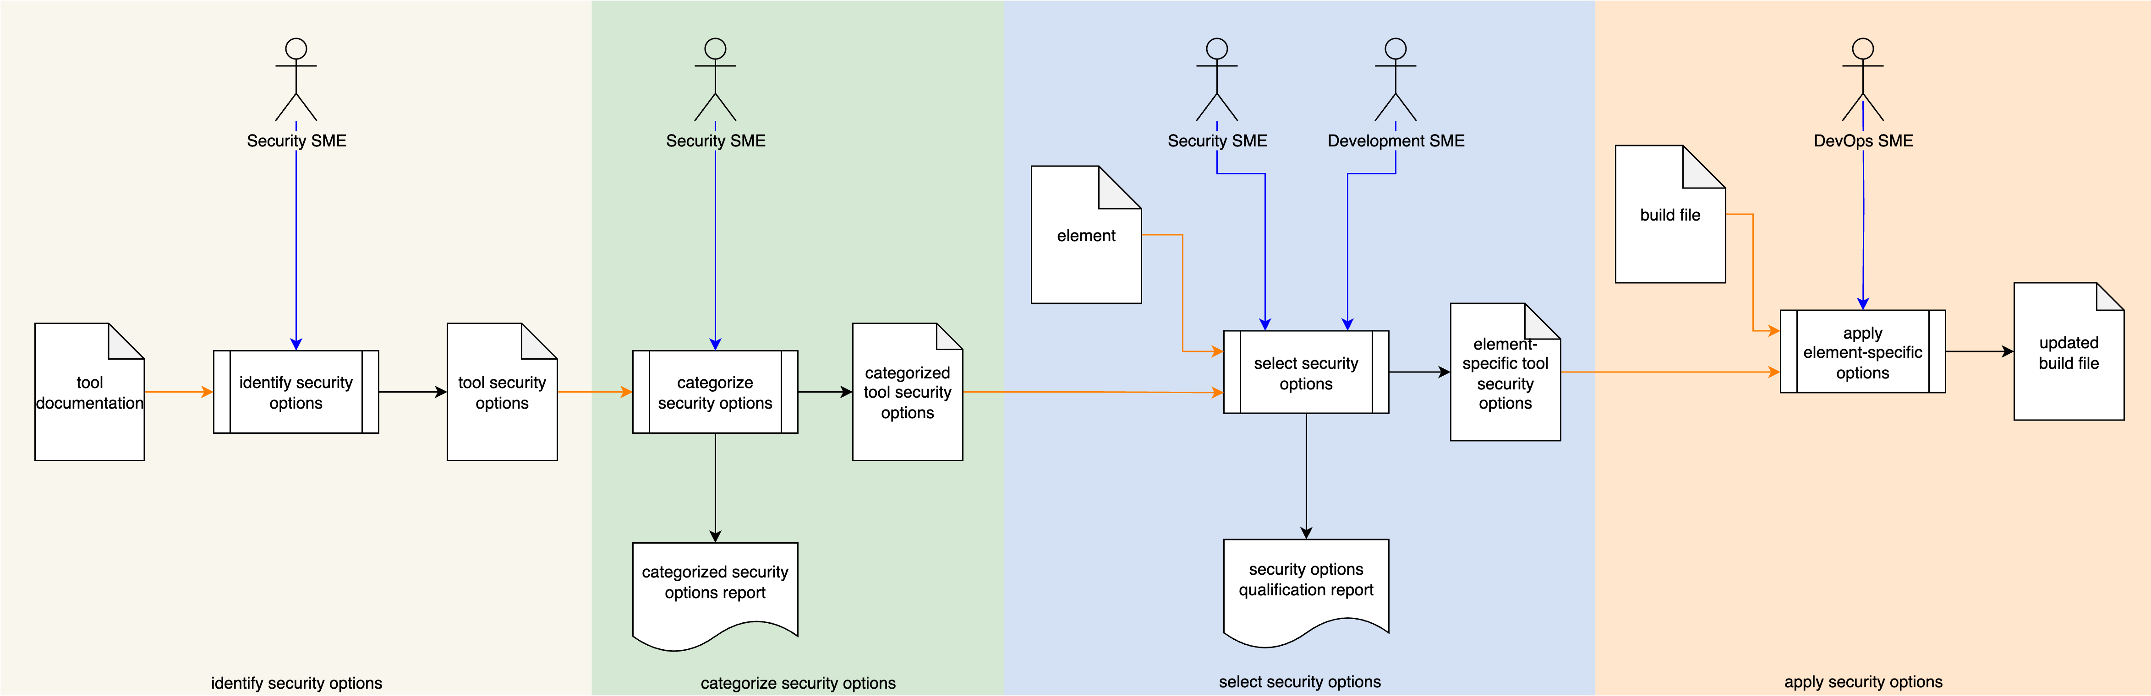
Secure Settings Process
Notes:
Script:
The secure settings process is comprised of four activities.
These are:
[break]
identifying the options relevant to security
[break]
categorizing those options
[break]
selecting which ones we're going to use for each element
[break]
and finally, applying those options to the build system for that element.

Slide 8
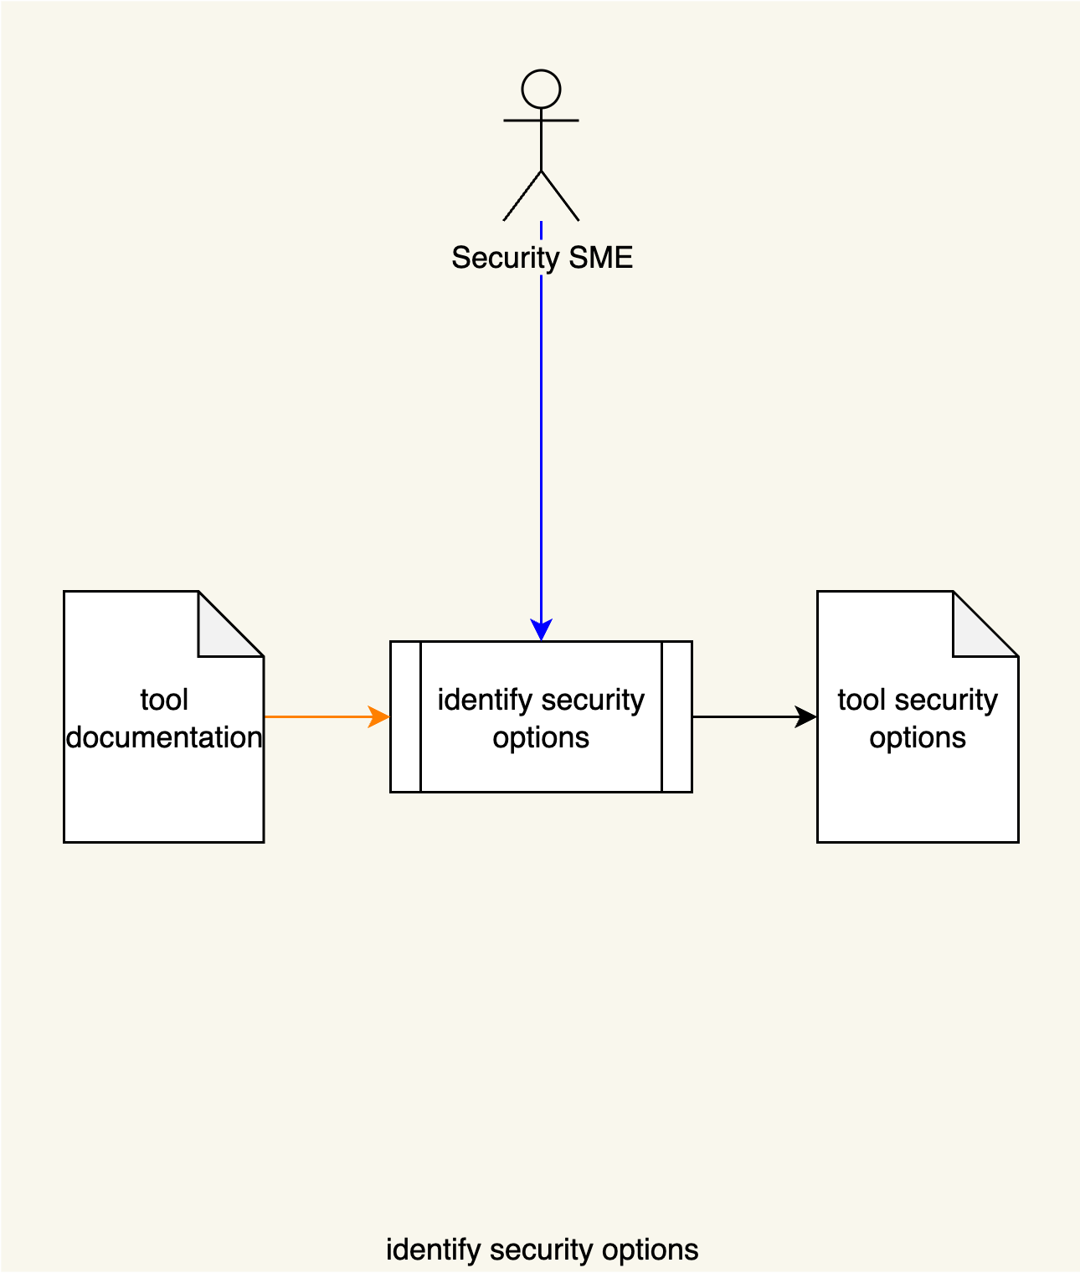
Secure Settings Process
Notes:
Script:
The secure settings process is comprised of four activities.
These are:
[break]
identifying the options relevant to security
[break]
categorizing those options
[break]
selecting which ones we're going to use for each element
[break]
and finally, applying those options to the build system for that element.

Slide 9
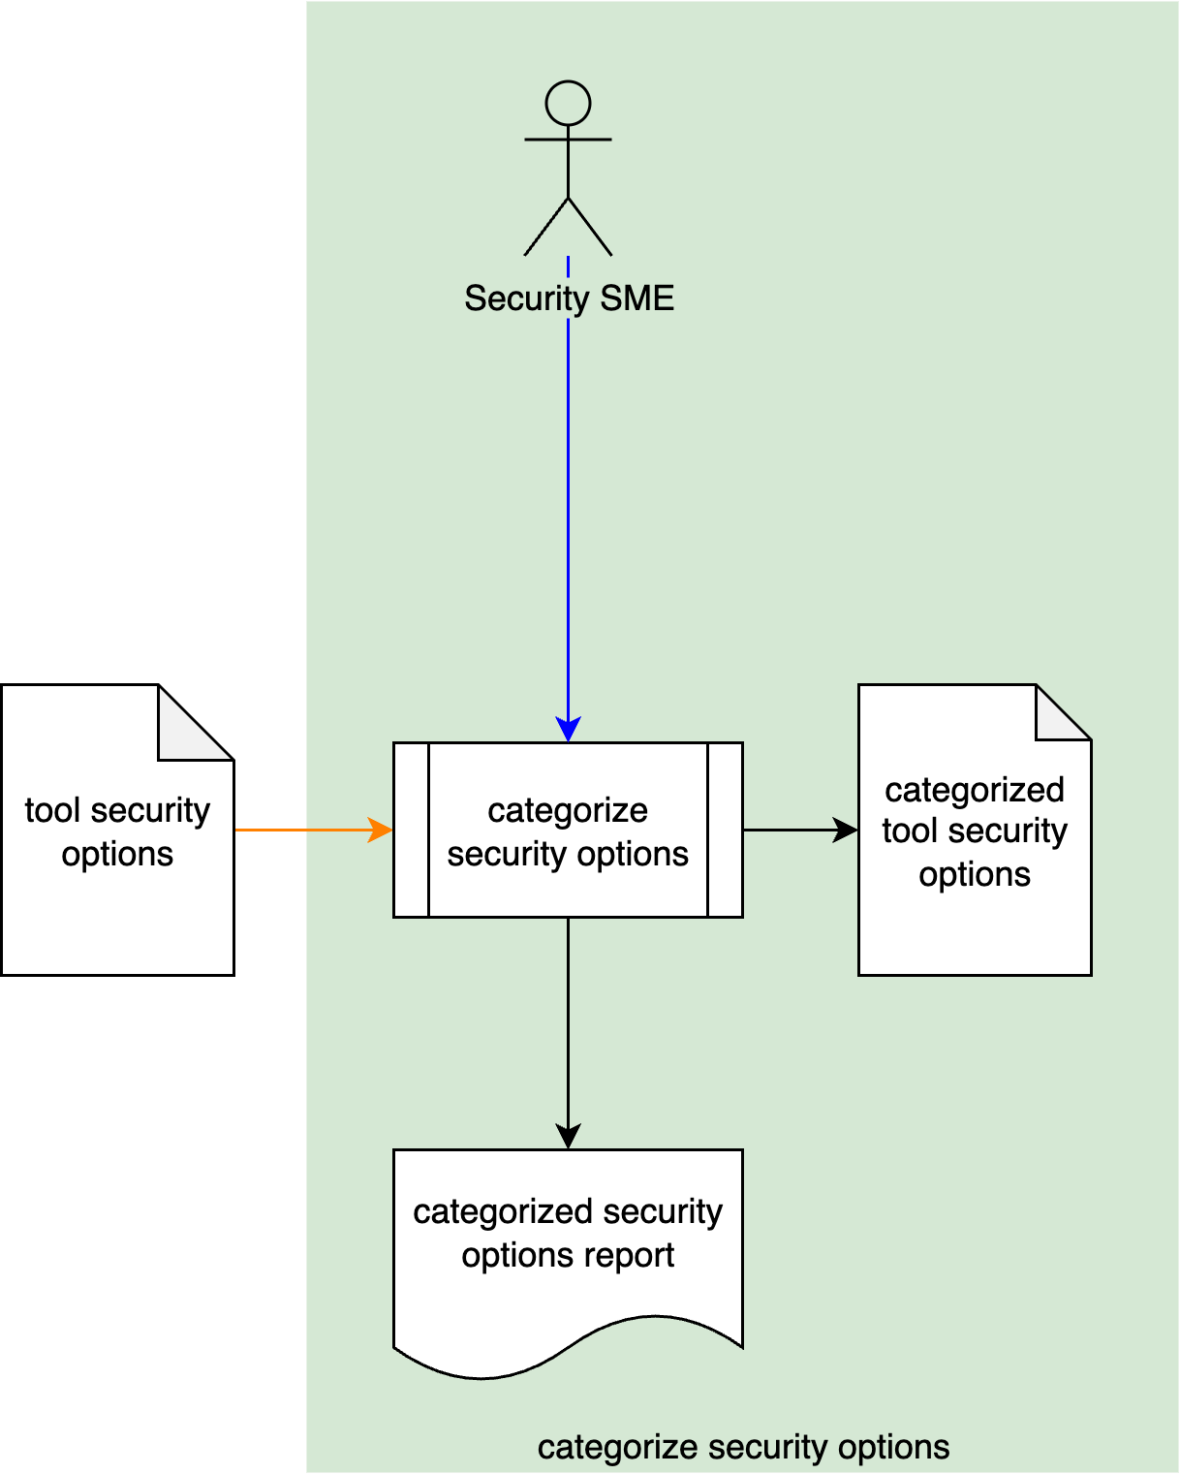
Secure Settings Process
Notes:
Script:
The secure settings process is comprised of four activities.
These are:
[break]
identifying the options relevant to security
[break]
categorizing those options
[break]
selecting which ones we're going to use for each element
[break]
and finally, applying those options to the build system for that element.

Slide 10
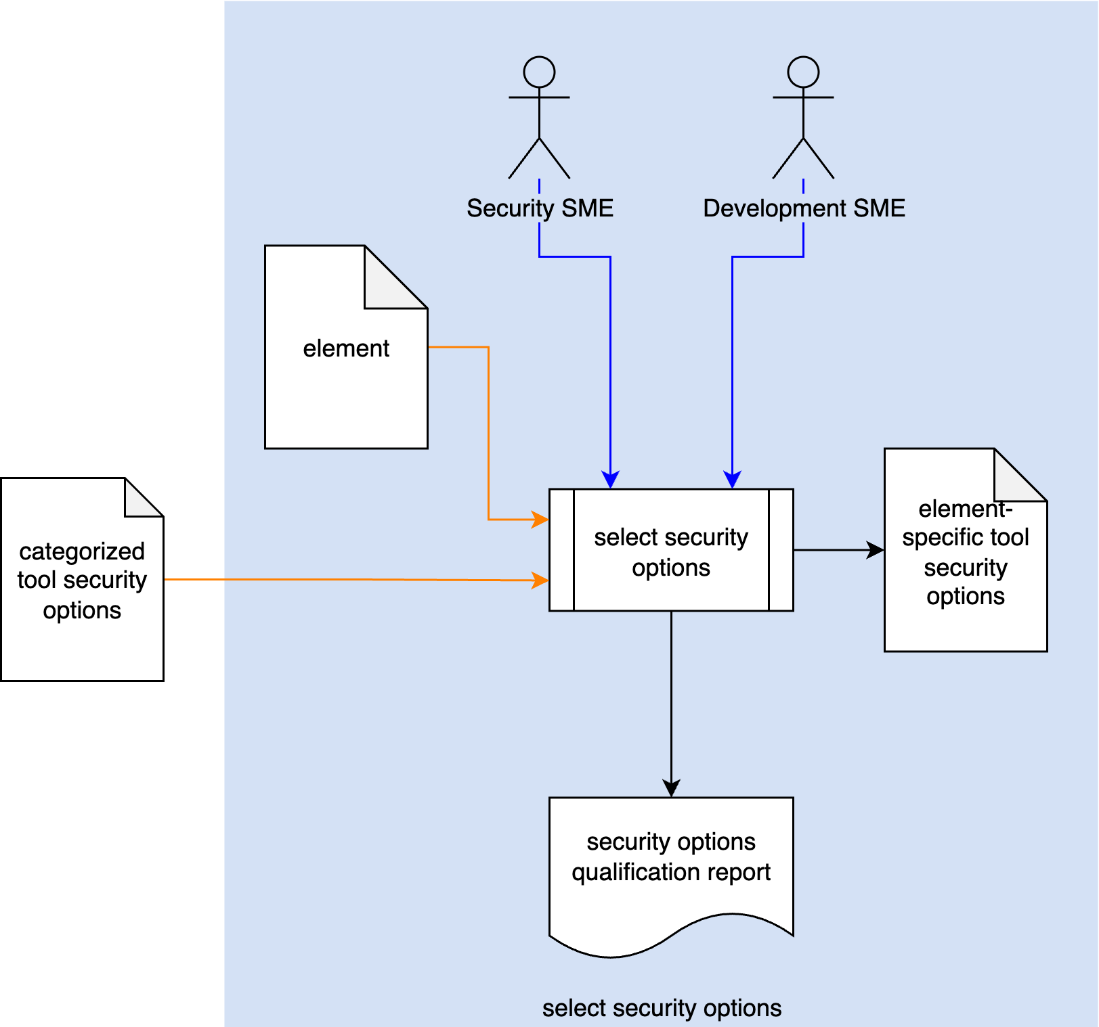
Secure Settings Process
Notes:
Script:
The secure settings process is comprised of four activities.
These are:
[break]
identifying the options relevant to security
[break]
categorizing those options
[break]
selecting which ones we're going to use for each element
[break]
and finally, applying those options to the build system for that element.

Slide 11
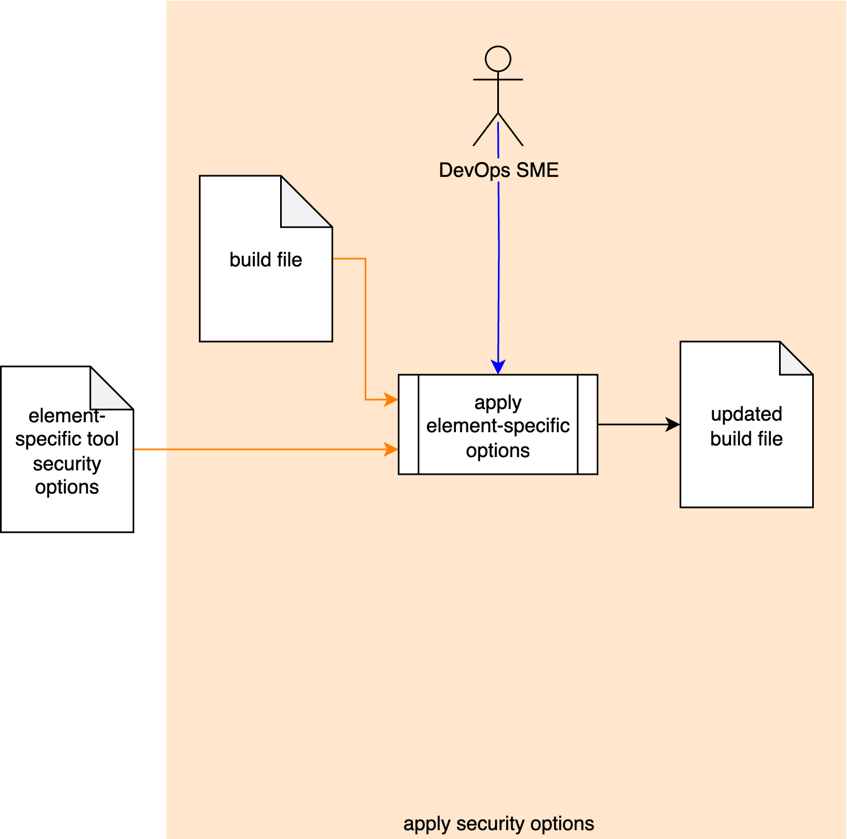
Secure Settings Process
Notes:
Script:
The secure settings process is comprised of four activities.
These are:
[break]
identifying the options relevant to security
[break]
categorizing those options
[break]
selecting which ones we're going to use for each element
[break]
and finally, applying those options to the build system for that element.

Slide 12
Secure Settings Material
Notes:
Script:
Now, let's briefly review the materials that provide both documentation and training for how the secure settings activities should be undertaken.

Slide 13
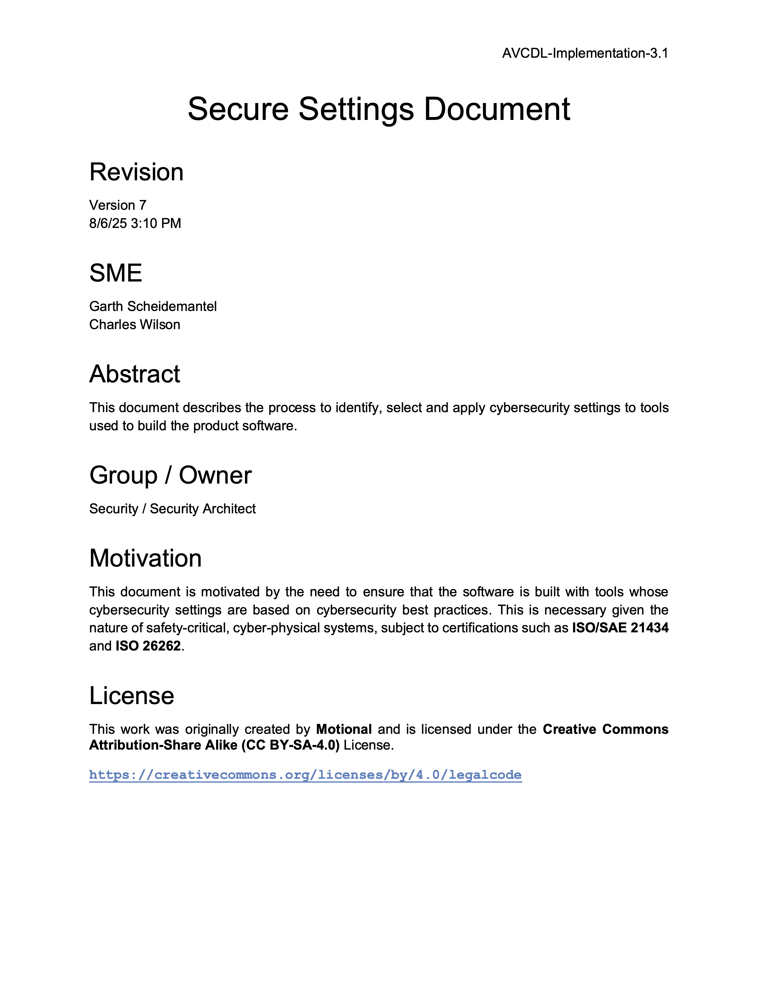
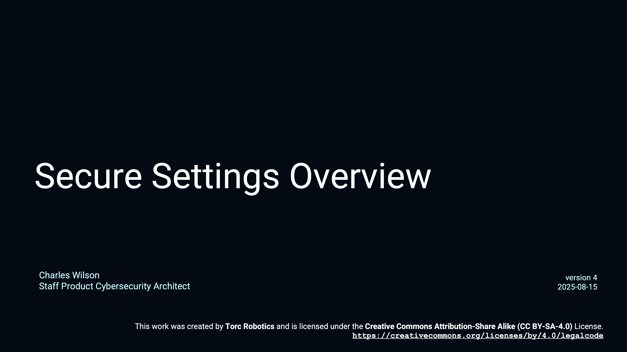
Secure Settings - Overview
Notes:
Script:
First, we have the Secure Settings Overview training video which compliments
the Secure Settings Document secondary document
and provides an overview of the secure settings process described in the AVCDL primary document.

Slide 14
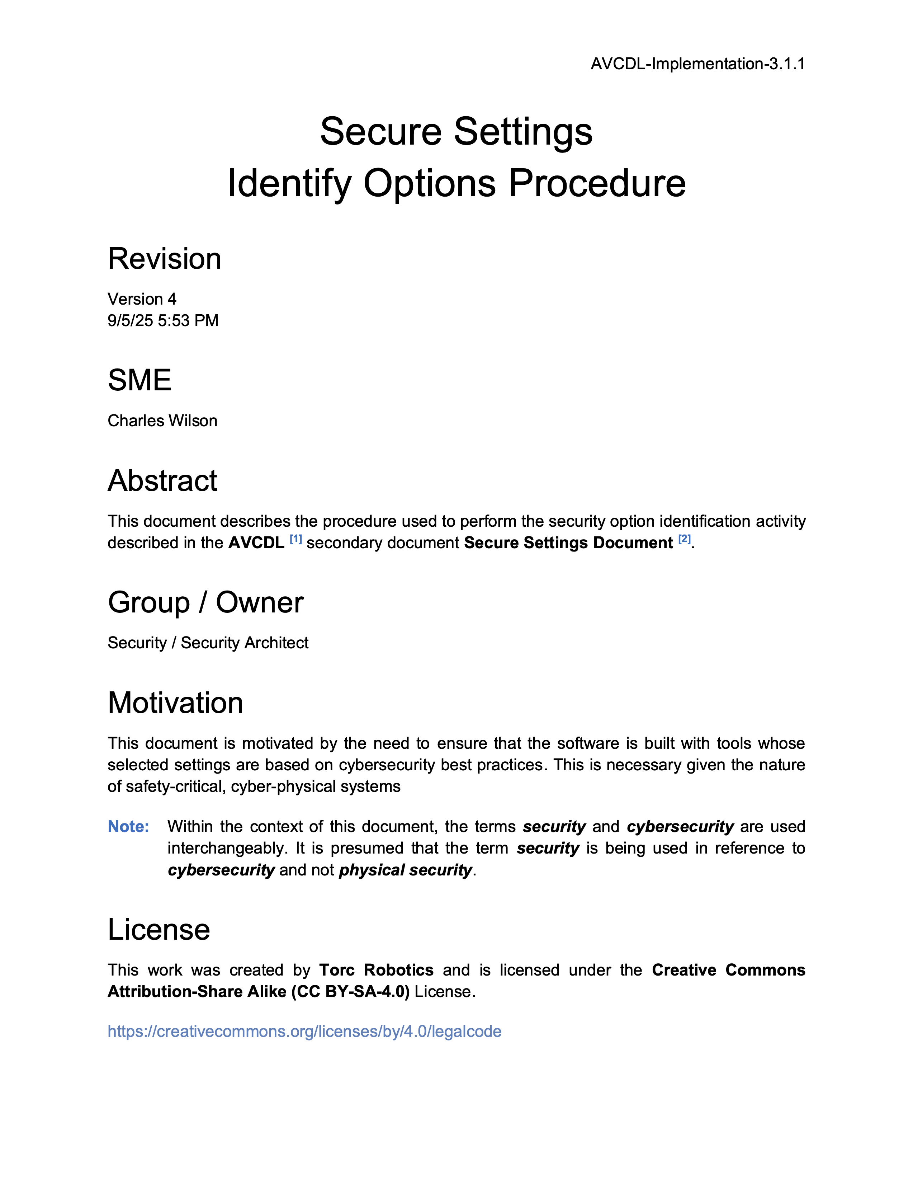
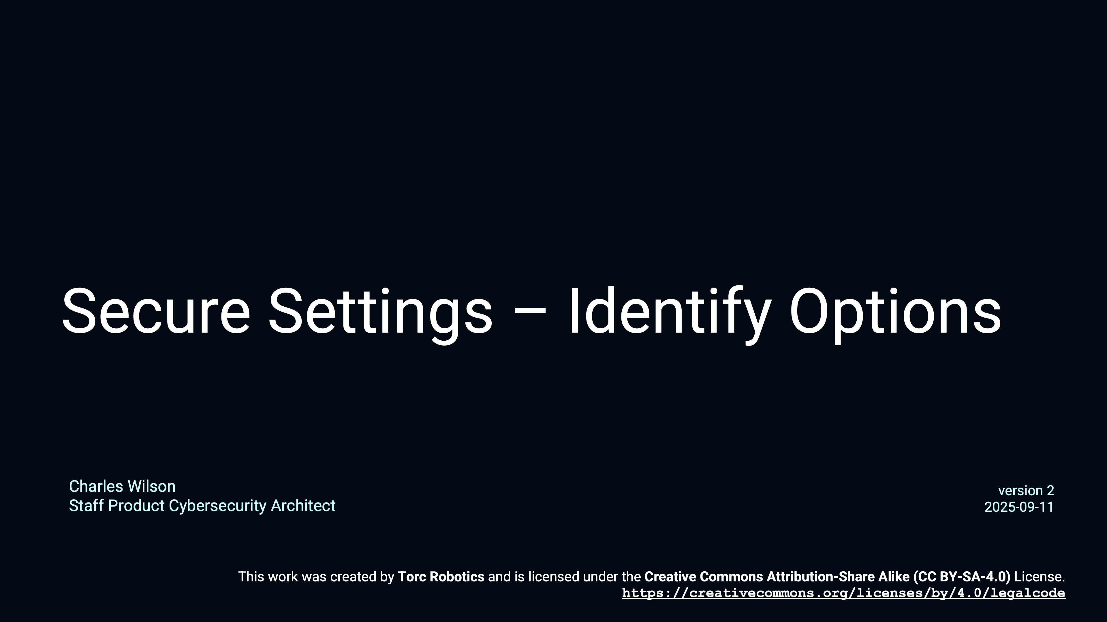
Secure Settings – Identify Options
Notes:
Script:
The Secure Settings - Identify Options training goes along with the Secure Settings Identify Options Procedure.
It works its way through an example using GCC as a basis covering how one would take a tool and extract the various options from it.

Slide 15
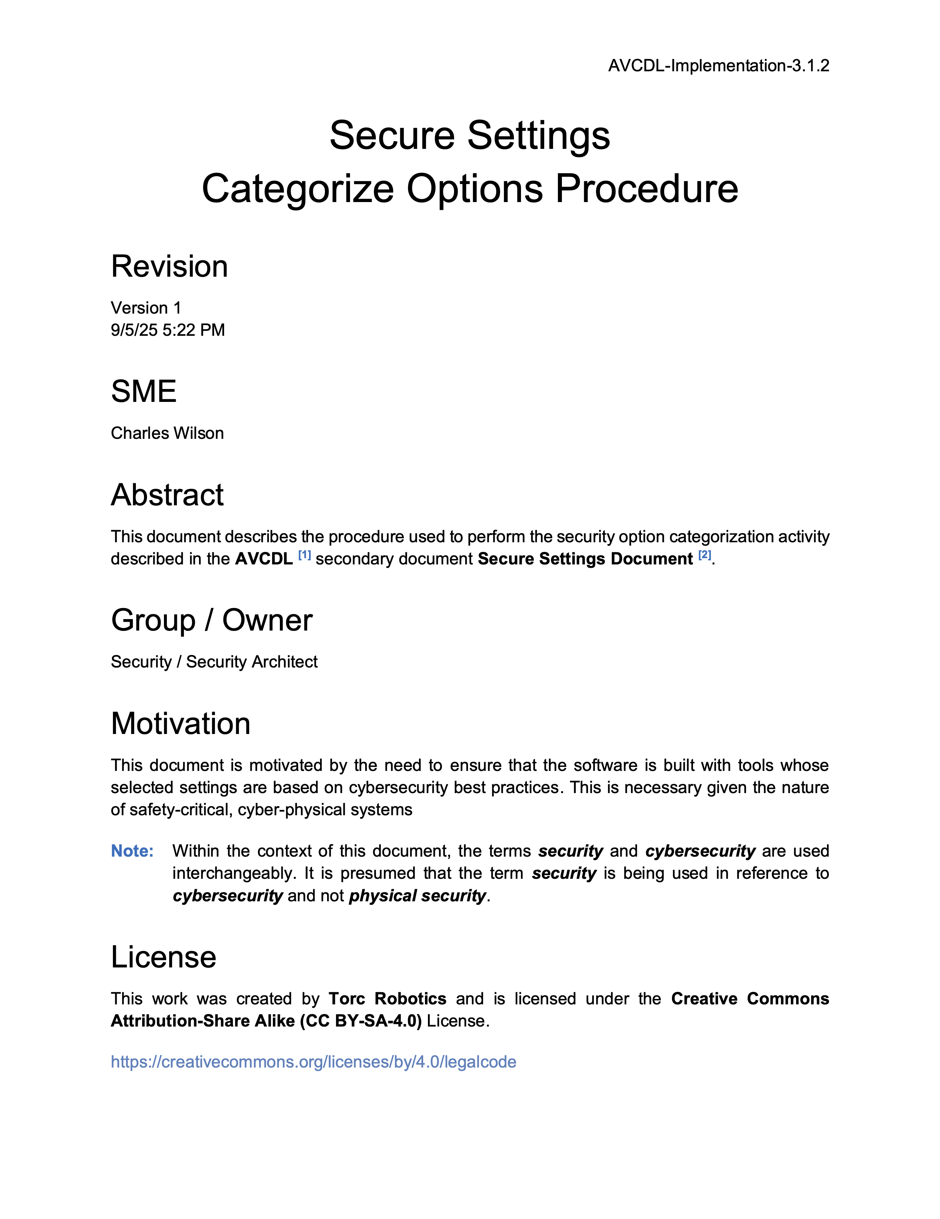
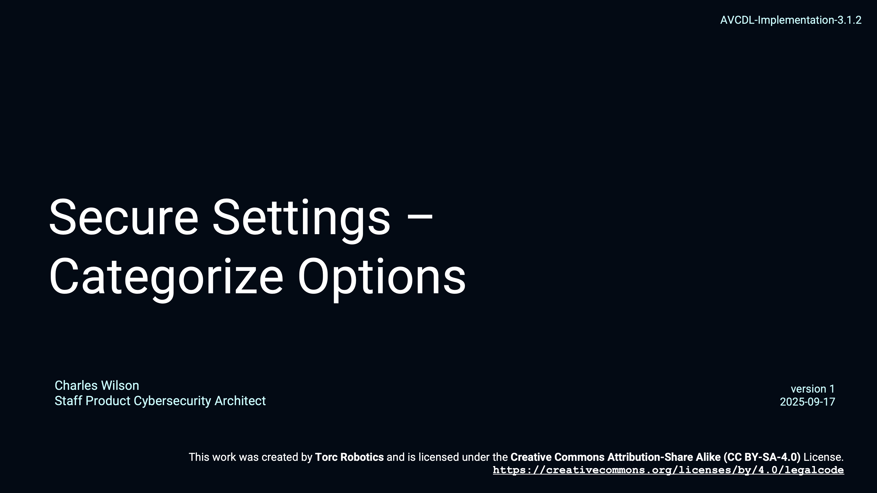
Secure Settings – Categorize Options
Notes:
Script:
The Secure Settings - Categorize Options training goes along with the Secure Settings Categorize Options Procedure.
It extends the example from the identify options training and covers how one might create severity categories and categorize the identified options so that they can be processed later.

Slide 16
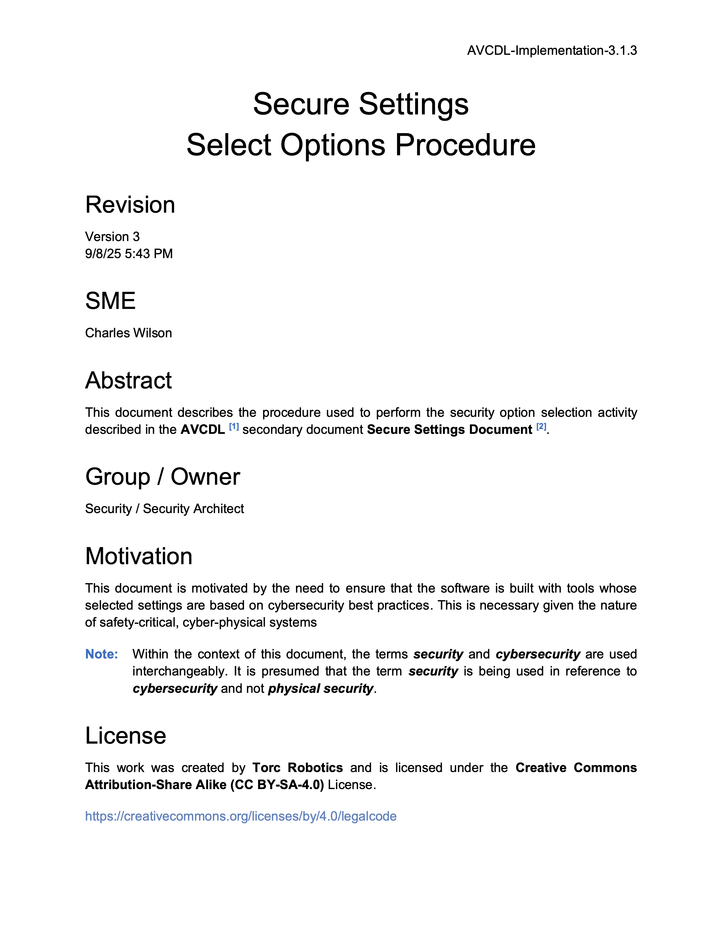
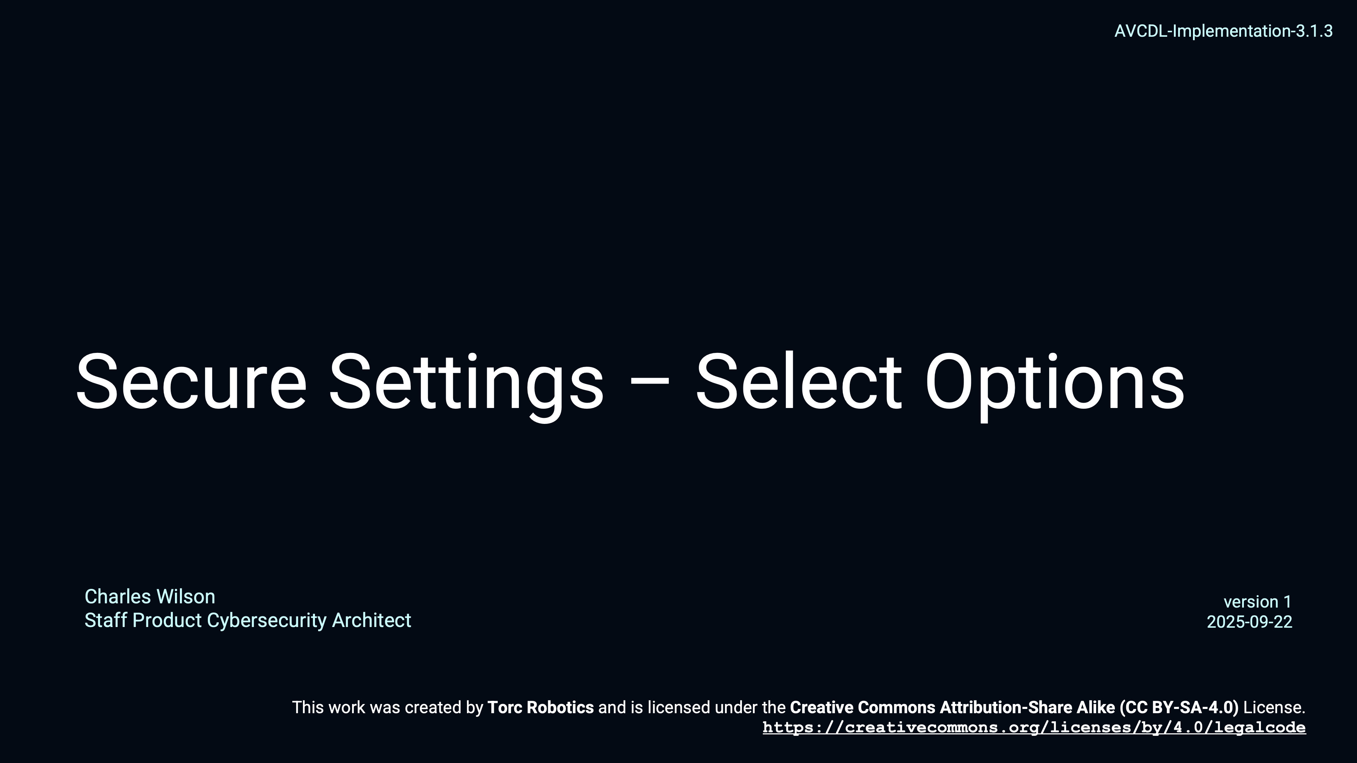
Secure Settings – Select Options
Notes:
Script:
The Secure Settings - Select Options training goes along with the Secure Settings Select Options Procedure.
It continues extending the example from the previous training and addresses how options are selected for application to a specific element of the system by the cybersecurity and development SMEs.

Slide 17

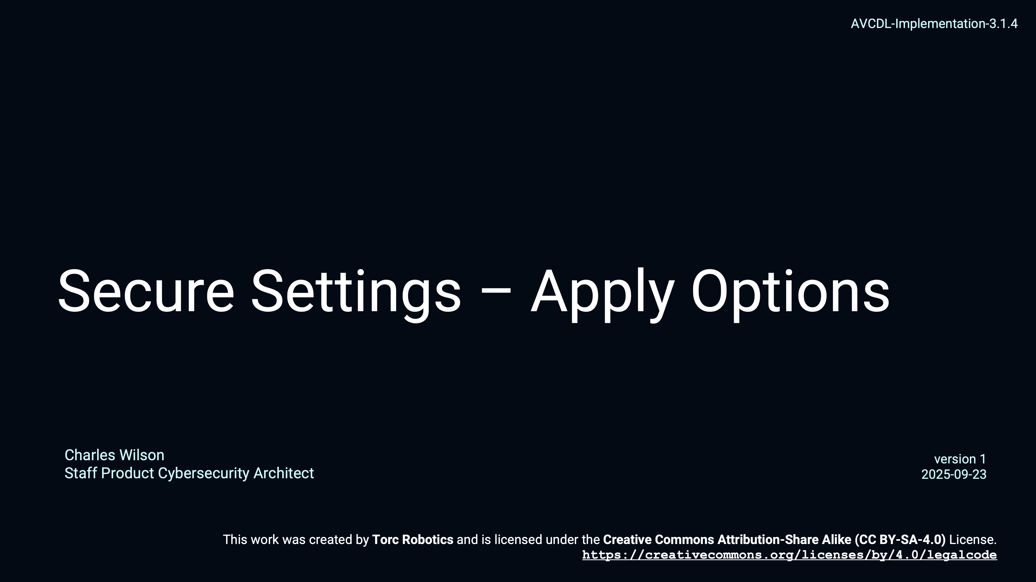
Secure Settings – Apply Options
Notes:
Script:
Finally, the Secure Settings - Apply Options training goes along with the Secure Settings Apply Options Procedure.
The focus here is on the devops SME, tasked with taking the options selected for application to a particular element, and making the adjustments to the build system to integrate those options.

Slide 18
Fuzz Testing Customization
Notes:
Script:
Unlike most of the AVCDL processes which are able to directly apply the secure settings process in order to establish the settings for a particular tool to be used, with fuzz testing we're dealing not with a specific tool but with a set of frameworks.
The way we're going to approach this is slightly different.
So, let's go back to the secure settings process and see how we're going to customize it for use with fuzz testing.

Slide 19
Secure Settings Process
Notes:
Script:
Here again is the secure settings process.
What we're going to do is customize
[break]
the first two processes of
[pause]
identification of the options and
[pause]
categorization of the options.
[break]
Zooming in on those from a fuzz testing standpoint, when we talk about
[pause]
the tool documentation, we're talking about the documentation of the fuzz testing framework that we're considering here.
[pause]
And our identification of the options is the context required in order to make those things work.
That gives us
[pause]
A set of options we can pick from to do our fuzz testing.
In our next step of categorization, what we're talking about for categories are the use cases.
The fuzz testing use cases are documented and a use case is assigned to each of the framework options.
This yields
[pause]
our categorized options.

Slide 20
Secure Settings Process (Fuzz Testing Customization)
Notes:
Script:
Here again is the secure settings process.
What we're going to do is customize
[break]
the first two processes of
[pause]
identification of the options and
[pause]
categorization of the options.
[break]
Zooming in on those from a fuzz testing standpoint, when we talk about
[pause]
the tool documentation, we're talking about the documentation of the fuzz testing framework that we're considering here.
[pause]
And our identification of the options is the context required in order to make those things work.
That gives us
[pause]
A set of options we can pick from to do our fuzz testing.
In our next step of categorization, what we're talking about for categories are the use cases.
The fuzz testing use cases are documented and a use case is assigned to each of the framework options.
This yields
[pause]
our categorized options.

Slide 21
Secure Settings Process (Fuzz Testing Customization)
Notes:
Script:
Here again is the secure settings process.
What we're going to do is customize
[break]
the first two processes of
[pause]
identification of the options and
[pause]
categorization of the options.
[break]
Zooming in on those from a fuzz testing standpoint, when we talk about
[pause]
the tool documentation, we're talking about the documentation of the fuzz testing framework that we're considering here.
[pause]
And our identification of the options is the context required in order to make those things work.
That gives us
[pause]
A set of options we can pick from to do our fuzz testing.
In our next step of categorization, what we're talking about for categories are the use cases.
The fuzz testing use cases are documented and a use case is assigned to each of the framework options.
This yields
[pause]
our categorized options.

Slide 22
Example
Notes:
Script:
Now let's work our way through an example of fuzz testing framework option identification and categorization.
We'll be using the AVCDL fuzz testing framework options template which is described in the Fuzz Testing – Establish Setting Procedure tertiary document that goes along with this training.
It's important to note here that this is just one mechanism for documenting this information.
There are any number of ways this information could be documented.
In an ideal world, you'd use a database to store this information both across frameworks and versions of frameworks.

Slide 23
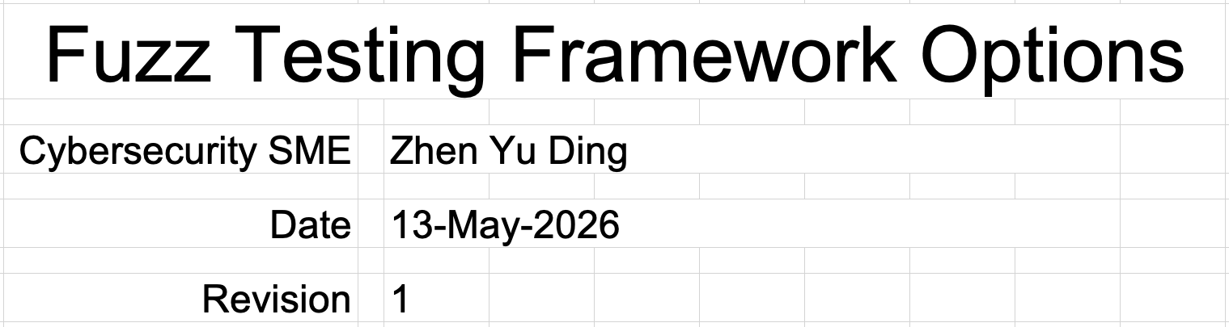
Cover Sheet
Notes:
Script:
For our example, we record
[pause]
the SME who is performing this activity,
[pause]
the date that the document was updated,
and finally,
[pause]
a monotonic and increasing version number.

Slide 24
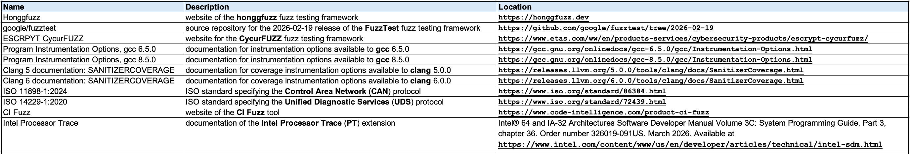
References Sheet
Notes:
Script:
In the references sheet what we have are
[pause]
The name,
[pause]
description, and
[pause]
location of the naterials that we use to construct the information in the remainder of the workbook.
Here, since we're dealing with fuzz testing frameworks, we're going to make sure that we enumerate all of those frameworks and provide the relevant references for them.
Additionally, since we're going to be doing categorization, we need to include any relevant references that we use in order to inform that activity.

Slide 25
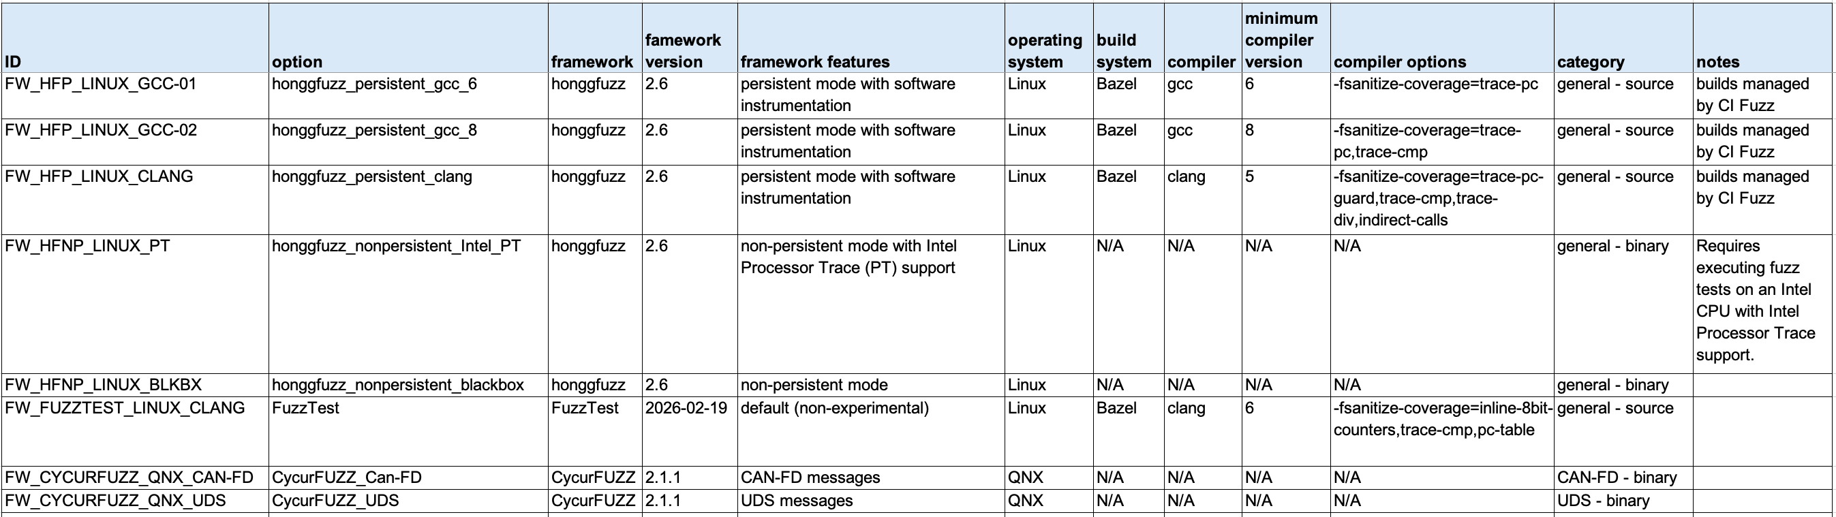
Options Sheet
Notes:
Script:
For the options themselves, we include the following information:
[pause]
a unique identifier
[pause]
the option name, which should also be unique
[pause]
the name of the framework
[pause]
the version of the framework
[pause]
The features of the framework relevant to the option.
This is important because frameworks typically provide more features than needed for any individual use case.
Next, we have
[pause]
the operating system for the option.
[pause]
If you have multiple operating systems that are being utilized, you should have an option for each.
The same is true for our next item which is
[pause]
the build system that's being used.
We then have
[pause]
the compiler,
[pause]
a minimum compiler version, and
[pause]
the compiler options required by with the framework option.
Next is
[pause]
the category, which we'll get to in a bit.
And
[pause]
a notes field.
[pause]
Looking at the first two entries.
We have FW_HFP_LINUX_GCC_1 and
[pause]
FW_HFP_LINUX_GCC_2.
What differentiates these is whether we're using
[pause]
GCC 6 and later, or
[pause]
GCC 8 and later.
The compiler options change, but everything else is the same.
Both use honggfuzz version 2.6 with identical features, targeted for Linux, built using Bazel, and managed by CI Fuzz.
Because the compilers, depending on the version, have different compiler options, we need to provide those as different line items so that when we do the next secure settings activity following identification and categorization,
that is the selection of options specific to the element under consideration,
we can select those most appropriate to the element’s particular build configuration.
[pause]
Contrast these with FW_FUZZTEST_LINUX_CLANG.
We see that the option name is simply FuzzTest, because it has no variants.
[pause]
You'll notice that there are three different fuzz testing frameworks here,
[pause]
honggfuzz,
[pause]
FuzzTest, and finally,
[pause]
CycurFUZZ.
Remember that you need not restrict your considerations to a single framework.
[pause]
So, this is how you approach enumerating the fuzz testing framework options.
The important thing is that you enumerate them all, so that you can be able to make appropriate selections for the elements under consideration.

Slide 26
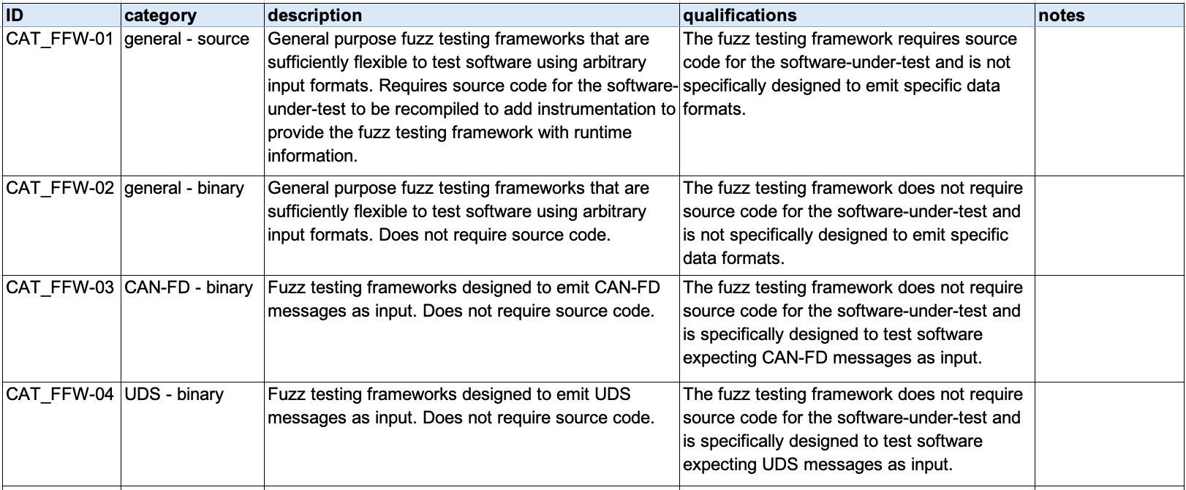
Categories Sheet
Notes:
Script:
This brings us to the next secure settings activity which is that of categorization.
To handle that, we use the categories sheet.
We’re going to consider the various use cases which represent the categories we use in the context of the secure settings.
As usual, we have
[pause]
a unique ID.
[pause]
The name of the category, which is also unique.
And since this category is going to be used to auto-populate the option sheet, we want these to be concise and clear.
Here you can see we have two general categories,
[pause]
one for source fuzz testing, and the other
[pause]
for binary fuzz testing.
We also have two specialized ones, one that's dealing with
[pause]
the CAN-FD protocol against a binary, and
[pause]
the UDS protocol also against a binary.
Next we provide
[pause]
a description which is as detailed as necessary so that we understand the use case.
Next we have,
[pause]
any qualifications which apply to the category.
These answer the question, what are the limitations imposed by this particular use case?
Finally, we have
[pause]
a notes field.

Slide 27
Options Sheet (Categorized)
Notes:
Script:
The last step in our categorization activity is to return to the option sheet and using the now auto-populated category list, select the appropriate category for each of the options that we've enumerated.
[pause]
As you can see here, the first three are all
[pause]
general - source options.
The next two are
[pause]
general - binary ones.
Next is another
[pause]
general - source one, this time for the FuzzTest framework.
And the last two are the two specialized ones.
The one for
[pause]
CAN-FD - binary used for CAN-FD analysis, and one for
[pause]
UDS - binary is being used for UDS analysis.
[pause]
With the options sheet completed, we've addressed the first two of the four secure settings activities.
The last two activities of selecting the options that we're going to use for the element and applying those options are performed as specified in the Secure Settings - Select Options and Apply Options procedures.

Slide 28
Fuzz Testing Considerations
Notes:
Script:
Since the Secure Settings process activities speak in general, let's talk about the specific things we need to consider when establishing the fuzz testing framework settings.

Slide 29
Considerations
Execution Time
Footprint
Isolation
Notes:
Script:
Aside from the typical, “is this element cybersecurity-relevant,” question when dealing with particular tools and settings,
[pause]
there are three considerations when dealing with the fuzz testing frameworks to be attached to various elements.
This is because fuzz testing is a part of the test suite.
And so, we first need to consider
[pause]
the execution time impact because the build system may be time bounded, and the addition of fuzz testing may well exceed any time bounding established for the build process.
We need to evaluate this before we recommend any option or framework for use with a particular element.
The second is very much akin to the first, and that is a consideration of
[pause]
the footprint.
This may be the overall code size impact, which is of concern when dealing with an embedded system where you have hard limits compared to when dealing with a desktop or server class machine.
Beyond the footprint of the code, you may have data memory footprint considerations.
Are you able to fit all of the necessary data into memory to be able to execute it efficiently and effectively?
Keep in mind that in real-time systems when using virtual paging, you have to take into consideration the memory footprint and the possible adverse effect of memory thrashing.
Finally, we want to consider.
[pause]
isolation of the various tests.
Because fuzz testing is usually performed by taking a corpus of known good inputs and mutating them, you need to ensure that this is being done in a way that allows you to be able to reproduce the results should an error condition occur.
Additionally, having fewer variables changing for a given run of a particular test is always desirable.

Slide 30
Recap
Notes:
Script:
That covers fuzz testing settings establishment.
Let's look at a summary.

Slide 31
Summary
Identify the frameworks
Categorize the options (enumerate the use cases)
Scope to the element
Update the build
Report the settings
Keep cybersecurity-relevancy in mind
Notes:
Script:
When implementing settings establishment for fuzz testing frameworks we:
• identify the frameworks to be used
• categorize the options (enumerate the use cases)
• scope the frameworks to be used based on option applicable to the element
• update the build to be able to incorporate the particular frameworks and any settings changes needed
• report the changes that we make to the build settings
and remember that when performing fuzz testing in a cybersecurity context to
• keep cybersecurity-relevancy front of mind

Slide 32
Example Materials
<AVCDL>/source/reference_documents/working_material/secure settings/
<AVCDL>/source/reference_documents/working_material/fuzz testing/
Notes:
Script:
The materials that were used to cover this example are in the location shown here.
It's important to note that the workbooks include all the sheets covered in this training.

Slide 33
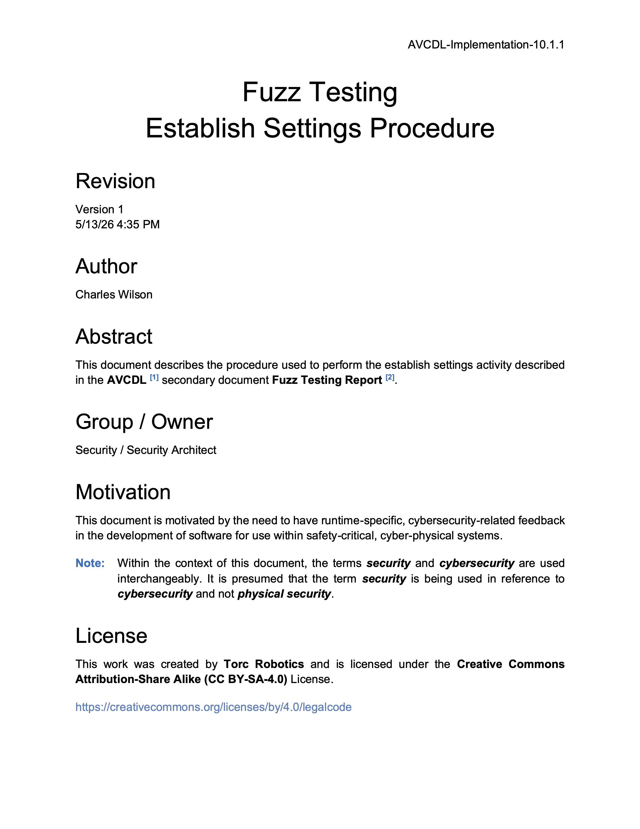
Further Reading
Notes:
Script:
For additional information and to get a more in-depth set of references, the Fuzz Testing Establish Settings Procedure tertiary document is available in the AVCDL GitHub repository.

Slide 34
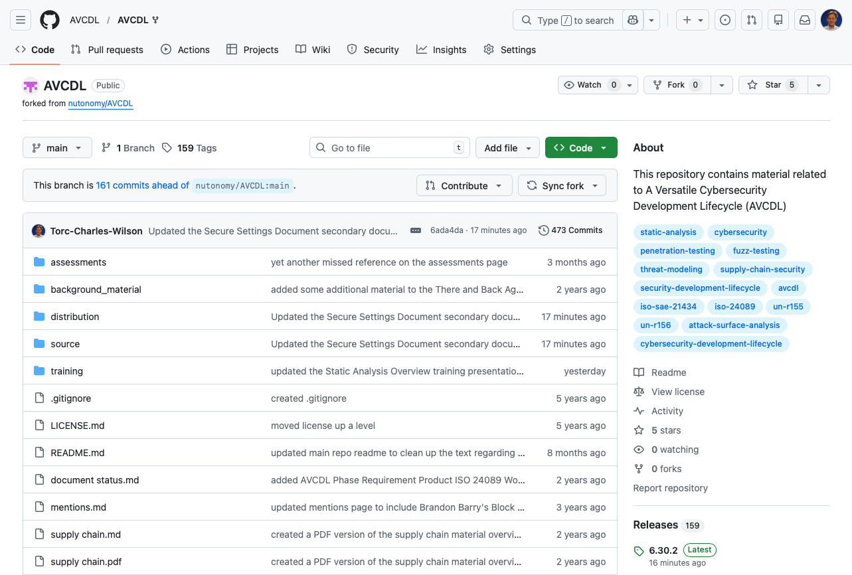
AVCDL on GitHub
https://github.com/AVCDL/AVCDL
Notes:
Script:
All AVCDL materials, both in source and distribution forms, are available on our GitHub site, as shown here.
Because of the size of the repository, it's recommended that you either clone the repository or download a ZIP archive of it, if you're not familiar with using git.
Instructions for downloading a ZIP archive are linked to on the repository’s front page.

Slide 35
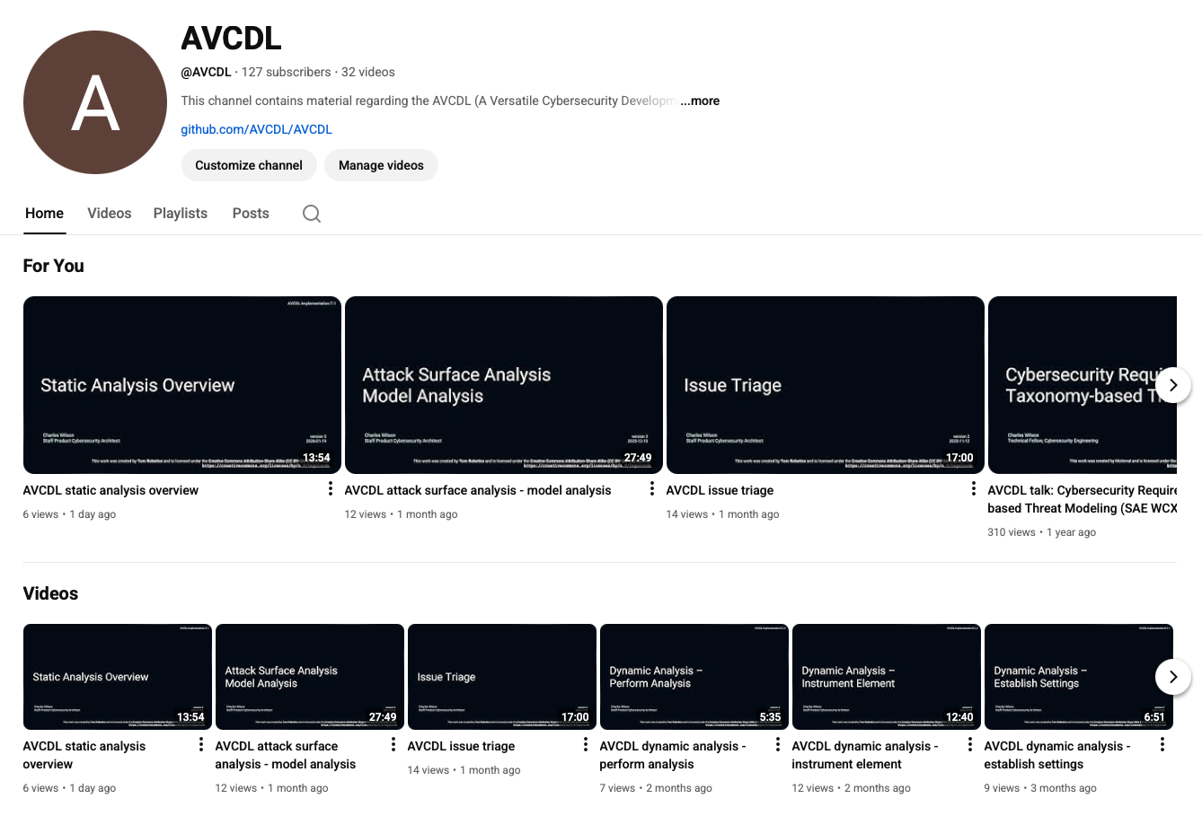
AVCDL on YouTube
https://youtube.com/@AVCDL
Notes:
Script:
Videos covering various aspects of the AVCDL are available on our YouTube channel, as shown here.
It's important to note that all AVCDL materials with the exception of the introductory blog posts are intended for product cybersecurity engineering practitioners.

Slide 36
Next Steps
Notes:
Script:
With this training complete, if you’ve completed the other trainings covering the Fuzz Testing process activities, you can proceed to the other trainings at this level, these include:
Static Analysis
Dynamic Analysis
and
Secure Code Review

Slide 37
References
AVCDL primary document
Fuzz Testing Report (AVCDL secondary document)
Fuzz Testing – Establish Settings Procedure (AVCDL tertiary document)
Secure Settings Document (AVCDL secondary document)
Secure Settings – Identify Options Procedure (AVCDL tertiary document)
Secure Settings – Categorize Options Procedure (AVCDL tertiary document)
Secure Settings – Select Options Procedure (AVCDL tertiary document)
Secure Settings – Apply Options Procedure (AVCDL tertiary document)
AVCDL fuzz testing framework options template (AVCDL template)
AVCDL tool cybersecurity options template (AVCDL template)
AVCDL element-specific tool cybersecurity options template (AVCDL template)
Notes:
Script:
Here are the references to the source material used in the creation of this presentation.
They'll also be included in the video description.
Additionally, this presentation’s source material will be provided on the AVCDL GitHub repository.

